Slide 1
The “Hear” and Now
Team Perspectives
Current Topics in Pediatric Audiology and Education of Deaf and Hard of Hearing Students
Presented by Members of the MSHA Audiology Subcommittee

Slide 2
Presenters
Lori Van Riper, Ph.D.
University of Michigan Mott Children’s Hospital
Kate Bolt, Au.D
Northview Public Schools/Kent ISD
Mary Jo Burtka, Au.D.
Redford Union Public Schools
Kate Salathiel, Au.D.
Lapeer County Intermediate School District
Samantha Kesteloot, B.S.
Lapeer County Intermediate School District

Slide 3
Overview
Early Identification and Early Intervention-Mary Jo
Population of kids in schools with hearing loss-Lori
Technology Update-Kate B.
Educational Accommodations-Samantha
Education Trends and Student Outcomes-Kate S.

Slide 4
EARLY IDENTIFICATION AND INTERVENTION

Slide 5
Joint Committee on Infant Hearing (JCIH) Benchmarks
Best practice recommendations are as follows:
Newborns are screened by 1 month of age,
A diagnostic audiological evaluation is done by 3 months of age, and
Intervention starts by 6 months of age.

Slide 6
Early Stats
American Academy of Otolaryngology –Head and Neck Surgery (AAO-HNS) estimates that 1 in 1000 babies are born profoundly deaf everyday.
Furthermore, 2-3 babies out of 1000 babies are born with partial hearing loss everyday.
This makes hearing loss the #1 birth defect.
Average age of identification is 13 months.
1 in 4 children does not receive a hearing loss diagnosis until 14 months of age.

Slide 7
Why do I need to have my baby’s hearing screened so early?
Children start their auditory memory for developing speech and language in the first six months of life.
The first three years are the most crucial for speech and language development.
The mind is like a sponge.
Those identified earlier have better language.

Slide 8
How is screening done?
85% of all newborns in the U. S. are screened.
Testing has to be done at an approved facility.
Many factors weigh into the first and/or repeat tests.
The earlier the better!!!
The sooner identified, the sooner intervention can begin!

Slide 9

Multidisciplinary Team
Diagnostic facility
Family themselves
Educational notification with local school district
Hearing aid dealer
Early On
Teamwork is the key!!!

Slide 10
Outcomes of Children with Hearing Loss (OCHL)
OCHL team members as a National Institutes of Health (NIH) -funded study
Outcome study of development of children with mild to severe hearing loss
Data on social, academic, and communication of these children
Overall snapshot of children in this study between time diagnosed and time when intervention was begun

Slide 11
What was the most significant factor in the time lag between when an infant was identified and intervention began?
Insurance coverage for tests and hearing aids
Birth order of the infant
Distance between testing facility and infant’s house
Mother’s level of education
Gross income of the household

Slide 12
OCHL Findings
Children with mild hearing loss tend to wear their hearing aids less than those with mod. to severe loss.
Some areas of speech and language tend to show more delays than others.
Good listening environments are important.
Quiet is better than noisy for listening!!

Slide 13
OCHL Findings
Most parents overestimate the amount of time their child is wearing hearing aids. How much time do they overestimate?
1 hour
2 ½ hours
4 hours
5 hours

Slide 14
OCHL Findings
Reasons reported for delay in intervention:
Pediatrician said to wait
Family and doctor didn’t believe there was a hearing loss as child would sometimes turn their head to sound
Family thought hearing loss was a temporary thing
Difficulty in scheduling appointments
May have passed Newborn Hearing Screening (NHS) but has progressive loss

Slide 15
OCHL Findings
Many children are not fit appropriately with hearing aids.
In a noisy situation, a hearing impaired child may not always follow the conversation. This impacts on further social skills.
Public awareness must be continued.
There is frequently confusion on how significant a hearing loss may be.

Slide 16
Helping Children Develop Listening
Book by Carol Flexer and Elizabeth Cole called Children with Hearing Loss: Developing Listening and Talking Birth to Six
Listening is a function of the brain, not the ear
Neural maturation is significant during the first 3 years of life
No auditory access then no auditory maturation!!!

Slide 17
Flexor/Cole cont.
Four steps to learning language:
Child’s amplification must be worn at all times
Reduce the noise!!!
Control the distance between the speaker and the child
Parents learn and use good communication strategies to strengthen auditory access

Slide 18
Mary Pat Moeller in Audiology Today (May/June 2010)
She wrote an article comparing normal hearing children and hearing impaired children in comparison with early word learning
Normal hearing children have milestones with word production, i.e. 12 months, 19 months,etc.
Children that are identified earlier with hearing loss progress at a slower rate.

Slide 19
Mary Pat Moeller article
Children who wear their hearing aids longer on a daily basis appear to learn words earlier.
Difficult situations for wearing hearing aids include family trips, playing outside, etc.
At 12-18 months, children start to understand more cognitively, i.e. “mom runs when I pull my hearing aids off”.
Auditory access is important for incidental learning. Hearing aids must be working!!!

Slide 20
Mary Pat Moeller article
Even children who got a cochlear implant at age 12 months, take longer to get their first words.
Factors such as distance and noise can interfere with good listening.
Good audibility with the hearing aids is essential for good speech and language development.

Slide 21
Mary Pat Moeller article
A child goes from 50 to 100 words quicker than the first 50 words.
True
False

Slide 22
Family as the Focus
Auditory Access for the child
Regular monitoring of the child’s hearing
Good communication between team members
Early intervention in local Intermediate School District (ISD)
Home visits between professionals

Slide 23
University of Western Ontario Pediatric Audiological Monitoring Protocol (PedAMP)
Goal of wearing amplification is to develop speech and language and good listening environments for learning.
To be successful in school, you have to learn to be a good listener.
Hearing aids are used to develop good communication skills.

Slide 24
PedAMP
Children with hearing loss resemble those with learning disability or language processing problems.
Unidentified hearing loss can affect higher education and job type.
School districts spend about 2 ½ times more on average to educate a hard of hearing or deaf student in Special Ed.

Slide 25
PedAMP
Assessment Tools
LittlEars Auditory Questionaire
Evaluates auditory behavior of infants esp. those who wear hearing aids or cochlear implants.
Can be used as a guide to see if child is developing auditory milestones
Grade 4 reading level and it takes 5 minutes

Slide 26
PedAMP
PEACH – Parents’ Evaluation of Aural Performance in Children
Addresses several different noise/quiet situations
Grade 6 reading level
A diary is kept for a week and parents observe the child’s auditory responses to various environments

Slide 27
Population of children with hearing loss

Slide 28

“Missing Children”
Children with hearing losses that are not “textbook” are overlooked.
Unilateral hearing loss
Mild hearing loss
Progressive hearing loss
Auditory Neuropathy

Slide 29
Otitis Media in School-aged Children
What is the average hearing loss in a child with otitis media?
10 dB
15 dB
18dB
24 dB

Slide 30
Otitis Media
All children with otitis media have some degree of hearing loss.
Speech may sound muffled to them and hearing may fluctuate.
Noisy environments, such as a classroom, can be challenging.
Thick fluid can cause up to a 45 dB hearing loss.

Slide 31

Success is quite simple!
Keep auditory access as simple as possible.
Be a team player.
Monitor these children!
Maintenance of good hearing aids is a must!
Get all the help that is needed, early!!!

Slide 32
Technology Update

Slide 33
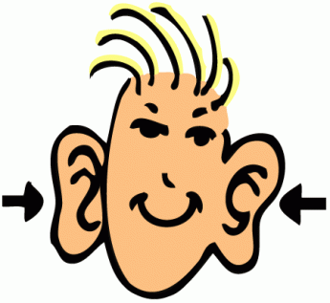
Technology for the ….

Slide 34
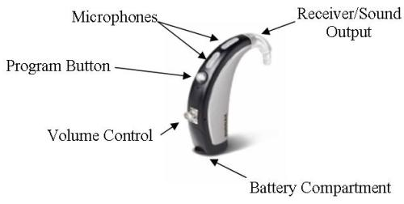
Hearing Aids
Traditional Amplification
  Analog?
  Digitally programmable?
“DIGITAL”
is the new
“TRADITIONAL”

Slide 35

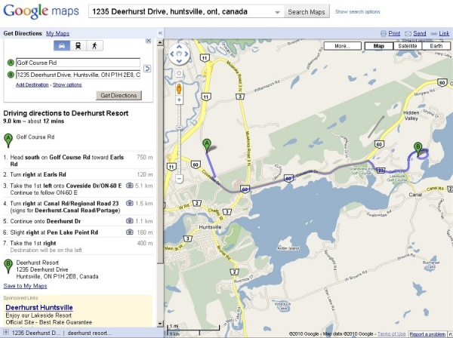
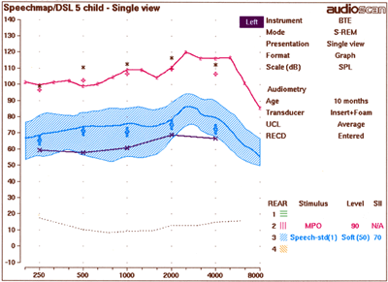
Speechmapping Goals
Prescriptive targets for the proper hearing aid settings are essential

Slide 36
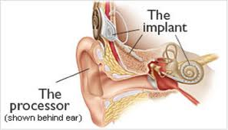
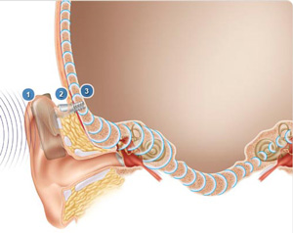
Other Hearing Devices
Cochear Implants
  Manufacturer
  Ear level vs. body worn
  Bimodal
Bone Conduction
  Bone conduction hearing aids
  Softbands
  Osseo integrated

Slide 37
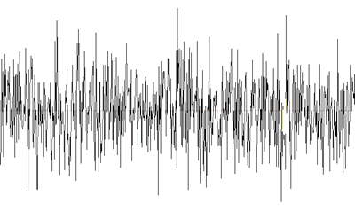
Hearing Technology and Noise
Noise levels of the classroom. Review Crandell and Smaldino, 2000
Speech room? Hallway? Outside/Field trips?
The problems with preferential seating.
Front of the class?
Teacher characteristics, topic, classmates, activities
What are the most challenging listening situations?
Notes:
KB
You Tube Demo – with Jane Madell
2011 Anderson, Smaldino, Spangler 15 questions on 3 point rating scale. Post that???
37

Slide 38
The average noise level measured in elementary classrooms is
20-30 dB
35-45 dB
55-65 dB
>70 dB

Slide 39

“Can you Hear me now?”
Recording simulating an FM microphone in a classroom.
Source: Theresa Derr & Scott Bradley, University of Wisconsin-Whitewater (www.Successforkidswithhearingloss.com)
Notes:
Demo of student listening in class without and with RM/HAT * You Tube : Pediatric Audiology Project “Hearing Loss in the Classroom”
39

Slide 40
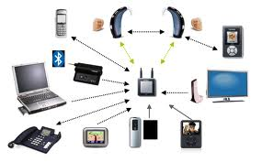
Connectivity = Access to Sound
Notes:
KB
40

Slide 41

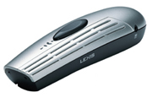
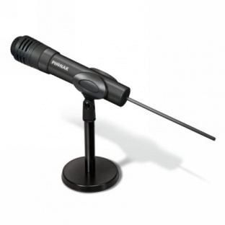
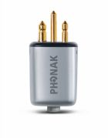
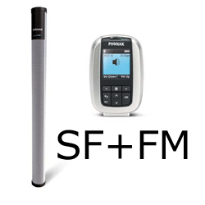

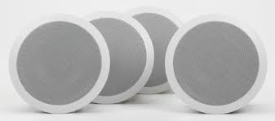
Hearing Assistive Technology/ HAT
Transmitters
  Microphone type
Receivers
  Personal
    Universal receivers
    Integrated receivers
  Soundfield speakers
    How many and where?

Slide 42
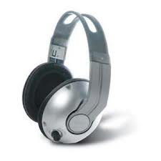
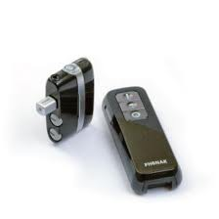
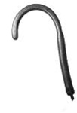
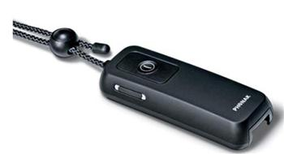
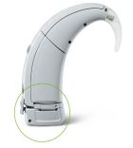
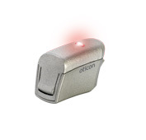
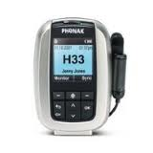
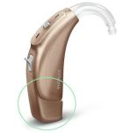
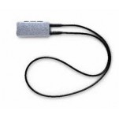
Home and School HATs

Slide 43


Slide 44
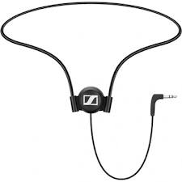
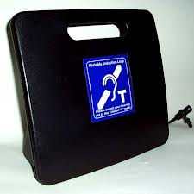
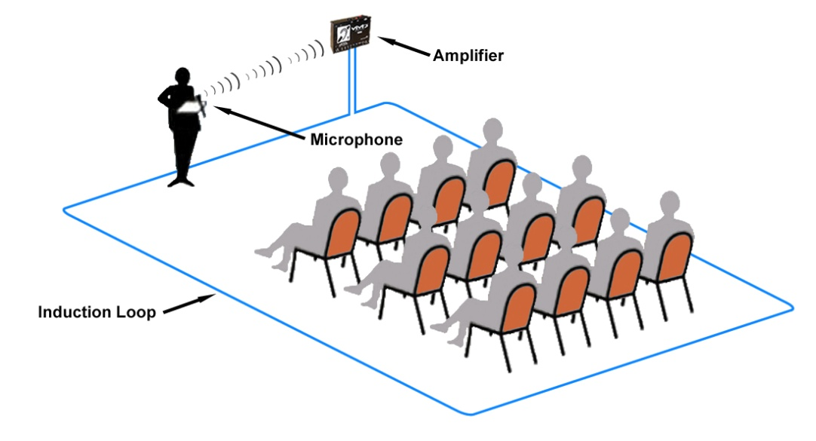
Induction Technology
Standard or digital
Loops
  Large Area, small area, ear level
  Hearingloop.org

Slide 45
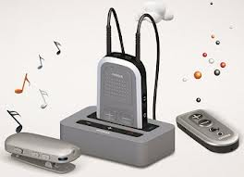
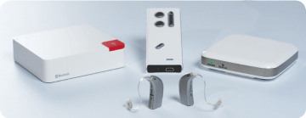
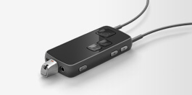
Bluetooth and Streamers
Phones
Cars
TV
Computers
FM systems

Slide 46
Laws that support optimal listening in the classroom:
Individuals with Disabilities Education Act (IDEA)
Section 504 of the Rehabilitation Act of 1973
Americans with Disabilities Act (ADA)
Notes:
KS
46

Slide 47
IDEA- Assistive Technology
Regulation 300.105 states in part that “each public agency must ensure that assistive technology devices or assistive technology services, or both, are made available to a child with a disability if required as a part of the child’s special education, related services, and supplementary aids and services. On a case-by-case basis, assistive technology devices in a child’s home or in other settings is required if the child’s IEP team determines that the child needs access to those devices in order to receive FAPE”.

Slide 48
Routine Checking of Hearing Aids and External Component of Implanted Devices
Public agency must ensure hearing aids are working properly
Public agency must ensure that the external component of implanted devices are working properly
Public agency is not responsible for post surgical maintenance, programming and replacement.
56.8% of all prescribed amplification at school was in use and functioning satisfactorily (DeConde-Johnson, 1998)
Notes:
KS
48

Slide 49
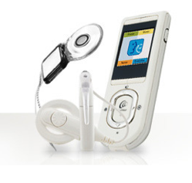
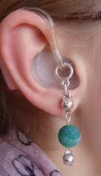
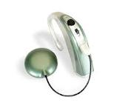
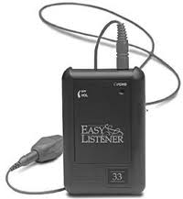
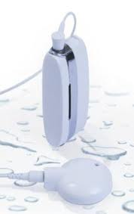
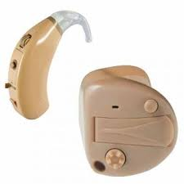
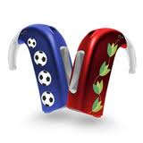
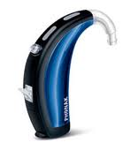
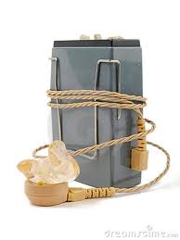
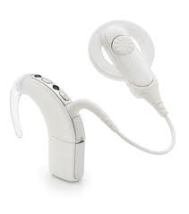
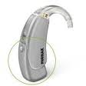
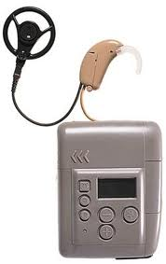
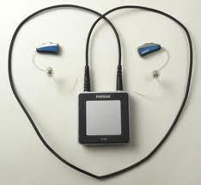
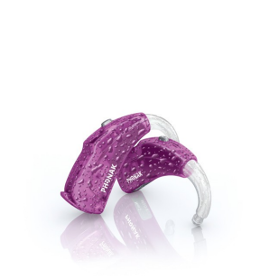
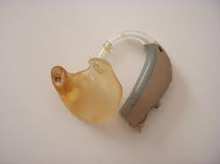
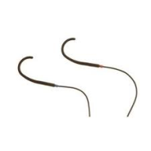
Take a closer look
Naughty
Nice
Notes:
49

Slide 50
Per IDEA, schools are responsible for the following
Checking and troubleshooting external components of a cochlear implant
Reimbursing mileage to attend appointments at the implant center
Replacing cords and accessories for the speech processor
Cochlear implant mapping if the school is > 100 miles from a center

Slide 51
References
Images from Phonak, Oticon, Advanced Bionics, Cochlear Corp, Front Row.
Video Demonstrations of FM in Classroom from one of the most awesome websites ever for home and school! WWW.Sucessforkidswithhearingloss.com
IDEA, 504, ADA – all available online websites compliments of the government

Slide 52
Accommodations in the classroom

Slide 53
Technological Accommodations
Hearing aids
Cochlear implants
Sound field systems
Personal FM systems
Real time captioning
Closed Captioning
Use of equipment
  Putting aids in properly.
  Turning systems on/ off, volume controls, etc.
  How will system be transported, charged, etc.
Notes:
SK

Slide 54
Other Accommodations
Face the student when talking & talk normally
Peer tutoring/ prompting
Note takers or written notes prior to instruction
Tape recorder
Study guides/ questions
Don’t call on student unless they volunteer
Visual cues for directions or equipment issues
Encourage student to repeat directions & ensure understanding
Testing
  Notecards, read test aloud, minimize distractions and provide quiet area.

Slide 55
What do our students say …
“You could take my FM but NOT my hearing aids.”
“I like when the teacher helps me extra.”
“The FM helps me pay attention best.”
“My cochlear implant makes me listen.”
“When I use the FM, I have to listen!”

Slide 56
Getting everyone on the same page
School day plans
  Discuss with parents, teachers and students a plan for student success.
Teacher letters
Peer in service about hearing loss, equipment, etc.
Be open to change and COMMUNICATE plan changes.
Be AVAILABLE to teachers, parents & students.

Slide 57
What can we do if a student refuses technology?
Nothing.
Explore the reasons why they don’t want HAT to see if the issues can be overcome with self advocacy.
Focus on less conspicuous accommodations such as preferential seating, clarification of directions, etc.
B & C
Answer: D- If a student refuses to use technology we must be innovative in showing its benefit and finding other ways to help the student cope with their loss of access to education. Every student is different!

Slide 58
Unilateral Hearing Loss
Possible Impact on the Understanding of Language and Speech | Possible Social Impact | Potential Educational Accommodations and Services
Child can "hear" but can have difficulty understanding in certain situations, such as hearing faint or distant speech, especially if poor ear is aimed toward the person speaking. Will typically have difficulty localizing sounds and voices using hearing alone. The unilateral listener will have greater difficulty understanding speech when environment is noisy and/or reverberant, especially when normal ear is towards the overhead projector or other competing sound source and poor hearing ear is towards the teacher. Exhibits difficulty detecting or understanding soft speech from the side of the poor hearing ear, especially in a group discussion. | Child may be accused of selective hearing due to discrepancies in speech understanding in quiet versus noise. Social problems may arise as child experiences difficulty understanding in noisy cooperative learning, or recess situations. May misconstrue peer conversations and feel rejected or ridiculed. Child may be more fatigued in classroom due to greater effort needed to listen, if class is noisy or has poor acoustics. May appear inattentive, distractible or frustrated, with behavior or social problems sometimes evident. | Allow child to change seat locations to direct the normal hearing ear toward the primary speaker. Student is at 10 times the risk for educational difficulties as children with 2 normal hearing ears and 1/3 to 1/2 of students with unilateral hearing loss experience significant learning problems. Children often have difficulty learning sound/letter associations in typically noisy kindergarten and grade 1 settings. Educational and audiological monitoring is warranted. Teacher inservice is beneficial. Typically will benefit from a personal FM system with low gain/power or a sound-field FM system in the classroom, especially in the lower grades. Depending on the hearing loss, may benefit from a hearing aid in the impaired ear.
Notes:
This is an example of a handout from Karen Anderson Website. It highlights the unique impacts faced by students with unilateral hearing losses and ideas for accomodations … there are many additional resources available on the web from professionals and teachers.

Slide 59
for more information
http://www.hearinglikeme.com/
https://successforkidswithhearingloss.com/
http://www.brighthubeducation.com/special-ed-inclusion-strategies/42913-hearing-impairment-teaching-strategies-for-an-inclusive-classroom/
http://www.brighthubeducation.com/special-ed-hearing-impairments/67528-tips-and-strategies-for-teaching-hearing-impaired-students/

Slide 60
Educational Trends and student outcomes

Slide 61

Changing Model in DHH Education and Student Outcomes
Expanded options for full access
  Karl White-Utah video

Slide 62
Gallaudet Annual Survey of DHH Children and Youth 1999 vs. 2011
Variable | 1999-2000 | 2009-2010
Parents hearing | 83.9% | 91.6%
Cochlear Implant | 4.47% | 15%
2nd Implant | n/a | 23.6%
CI still used |  | 91.2%

Slide 63
Gallaudet Annual survey cont…
Variable | 1999-2000 | 2009-2010
Special or center school | 28.7% | 24.3%
Gen Ed | 44.8% | 57.1%
Self cont. class in school | 30.4% | 22.7%
Resource Room | 12.6% | 11.9%

Slide 64
Gallaudet Annual survey cont…
Variable | 1999-2000 | 2009-2010
Sign Language Instruction | 6.17% | 27.4%
Spoken Language | 44.3% | 53%
Sign and Speech | 48.39% | 12%
Spoken with cues | .43% | 5%

Slide 65
Of all services provided to student who are DHH, which is
most frequently provided?
Itinerant teacher for the DHH
Tutoring
Speech and language
Interpreter

Slide 66
Gallaudet Annual survey cont…
Variable | 1999-2000 | 2009-2010
Coexisting Conditions | 41.4% | 39.9%
CART, C Print, Typewell | .9% | .3%
Itinerant Teacher | 34% | 41.5%
Interpreter | 22.1% | 13.7%
Speech and Language | 63.6% | 58.7%
Tutoring | 6.0% | 8.0%
Counseling | 8.3% | 9.9%

Slide 67
IDEA and Least Restrictive Environment /Change in educational placement
year | <21% out of Gen Ed | 21-60% out of Gen Ed | >60% out of Gen Ed | Separate facility
1988-89 | 26.9% | 21% | 33.6% | 18.6%
1992-93 | 29.4% | 19.7% | 28.1% | 22.7%
2005-06 | 48.3% | 18.7% | 19.5% | 13.4%
Michigan | 53.6% | 17.9% | 21.% | 7.3%

Slide 68
Lapeer County ISD Service Delivery Comparison: Past (2006) vs. Present (2012)

Slide 69
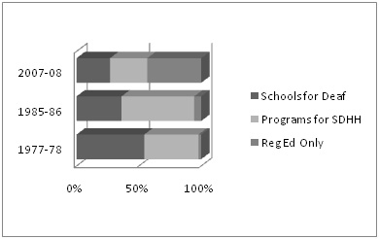
Gallaudet Annual Survey 2007-2008
Data from Deaf Students and Their Schools: The Changing Demographics by T. Karchmer, M. Allen & S. Brown, 1988, Washington, DC: Gallaudet Research Institute, and Regional and National Summary Reportof Data from the 2007-08 Annual Survey of Deaf and Hard of Hearing Children and Youth by Gallaudet Research Institute, 2008, Washington, DC: Author.

Slide 70
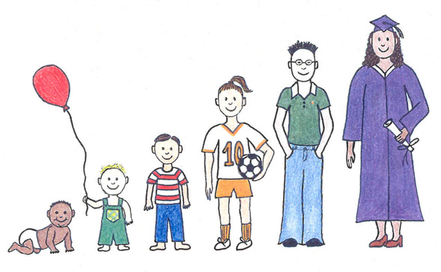
Academic Status of DHH students in Gen Ed. Longitudinal Study Antia 2009
N=197
Mild to profound hearing loss
Attended gen ed for 2 or more hours per day
For 5 years analyzed standardized test scores
  Reading
  Language/writing
  Math
  Teacher rating of academic competency
Motivated by the steady increase in the number of DHH students attending general education classrooms due to legislation and the growing movement toward inclusion

Slide 71
Results
Percentage of students scoring average or above
average on standardized assessments
63-79% in math
48-68% in reading
55-76% in language/writing
80% of students averaged at least a year’s progress in a year’s time
70-80% of teachers rated students as average or above average
90% of students made at least average progress
The standardized test scores for the group were, on average half a SD below hearing norms

Slide 72
Improvement from previous studies
“Lag far behind what is expected of their hearing peers at similar ages or grade levels (Allen 1986)
“By high school, about 50% of a national sample of DHH students were performing below basic proficiency levels in reading comprehension and math problem solving (Traxler 2000)
“However, DHH students who receive their instruction in general education classrooms are reported to have higher academic achievement than those who receive instruction in self contained classrooms (Kluwin & Stinson 1993)

Slide 73
Wolk and Allen 1984, Blair et al, 1985
Stanford achievement test between 1974 and 1979 noted scaled score growth of 3.6 points annually, about 1/3 of a grade equivalent change per year
Pure Tone Average (PTA) less than 50 dB had scores commensurate with hearing peers
PTA greater than 50 dB scored in the low average range for reading and math on standardized assessments.
Reading comprehension is approximately 6 grades below hearing peers by age 15 (Karcher and Mitchell 2003)

Slide 74
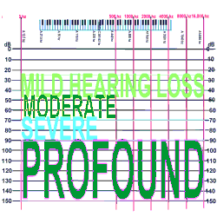
Recent Findings-reported by antia and team
Degree of hearing loss is not strongly associated with academic success (Powers 2003)
Students with mild hearing loss may have lower achievement than those
with moderate or severe
(Most 2004, 2006)

Slide 75
Social Outcomes- Antia, et al. 2011
Mean ratings from teachers and students are similar to those reported for normative sample
This remained stable over 5 years
“Member of” not “visitors to” the gen ed. classroom

Slide 76
Why are student in Gen Ed doing better??
“Academic Press”
  Teacher expectations
  School policies
  Academic standards
Increased exposure to general education curriculum
OR…
DHH students who are high achievers are placed and remain in gen ed.

Slide 77
Factors associated with academic achievement
Participation in classroom communication
Good receptive and expressive communication skills
Use of oral communication
Age of Identification
Age of enrollment in early intervention
Family involvement in education
Knowledge of school program
Ability to help with homework
Expectations and “press” for achievement

Slide 78

Reed 2008
Successful students has many child, family, and school “facilitators” in place
Unsuccessful students had few “facilitators” and many “detractors”

Slide 79
DHH students in General Education are performing…
Commensurate with hearing peers on standardized testing
½ standard deviation below hearing peers
1 standard deviation below hearing peers
3 standard deviations below hearing peers

Slide 80
Academic success is directly related to degree of hearing loss.
True
False

Slide 81
Good News, not so good news
According to Antia and team
Good News –we’ve covered that….
Not so Good News
“The DHH group is approximately half a standard
deviation behind norms and, despite making progress, may not be closing the gap particularly in reading”

Slide 82
What we know, what we can do
Students in general education classrooms are making greater gains than previously implied and are capable of learning along side hearing peers.
To help close the “gap” focus should be on communication skills and supports that influence success, strategies for using interpreters, participating on classroom discussions, repairing communication breakdown, and self advocacy to improve communication environments and participation.

Slide 83
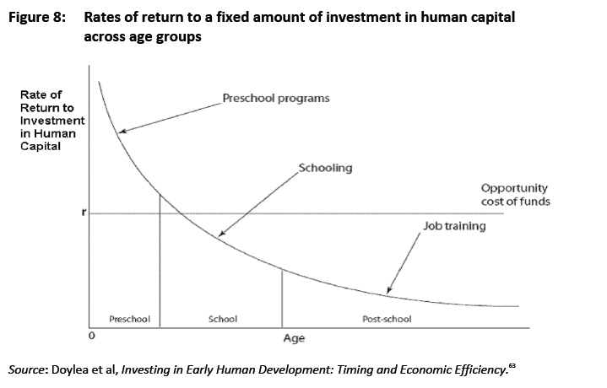

Slide 84
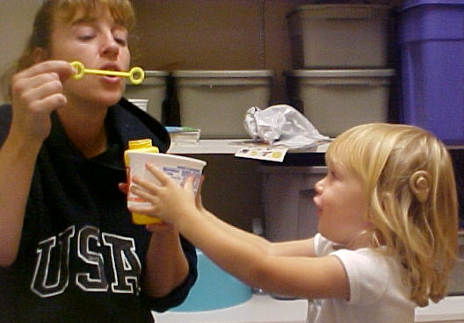
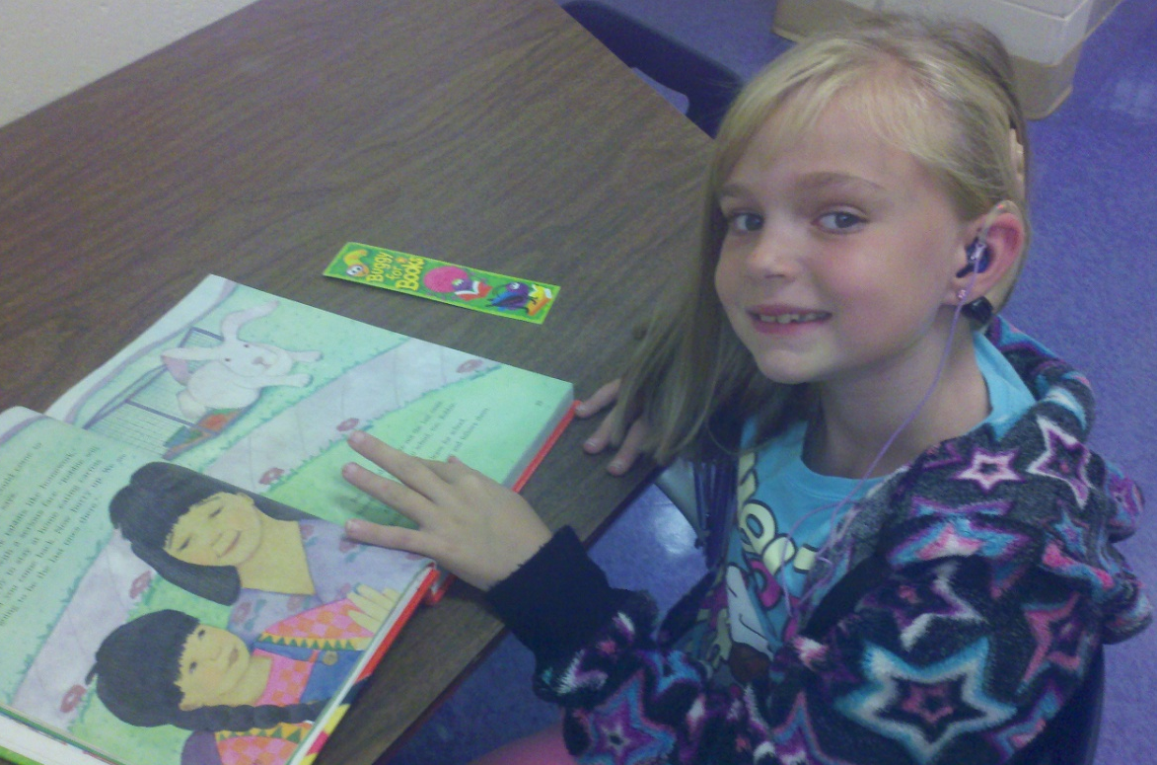
Thank you for your attendance and participation!!!

Slide 85
References
Allen, T. (1986). Patterns of academic achievement among hearing impaired students: 1974 and 1983. In A Schildroth & M. Karchmer (Eds.), Deaf children in America (pp. 161-206). Boston: Little Brown.
American Academy of Otolaryngology- Head and Neck Surgery. (2011 October 31). Fact Sheet: The Necessity of Early Intervention in Hearing. Retrieved from http://www.entnet.org/HealthInformation/EarlyHearingHealth.cfm
Antia, D.S., Jones, P.B., Reed, S., & Kreimeyer, K.H. (2009 June 8). Academic Status and Progress of Deaf and Hard-of-Hearing Students in General Education Classrooms. Journal of Deaf Studies and Deaf Education, 14. Oxford University Press. Obtained at http://jdsde.oxfordjournals.org/
Blair, J.C., Peterson, M.E., & Viehweg, S.H. (1985). The effects of mild sensioneural hearing loss on academic performance of young school-age children. The Volta Review, 87, 207-236.
Child Amplification Laboratory, National Centre for Audiology, UWO. (2010). The University of Western Ontario Pediatric Audiological Monitoring Protocol Version 1.0, Revision 2.
Gallaudet Research Institute (April 2011). Regional and National Summary Report of Data from the 2009-10 Annual Survey of Deaf and Hard of Hearing Children and Youth. Washington, DC: GRI, Gallaudet University.
Karchmer, M., & Mitchell, R. E. (2003). Demographic and achievment characterisitics of deaf and hard-of-hearing students. In M. Marschark & P.E. Spencer (Eds.), Oxford handbook of deaf studies, language and education (pp. 21-37) New York: Oxford University Press.
Lisonbee, Dale L. (date of publication). [Book Review of Children with Hearing Loss: Developing Listening and Talking Birth to Six]. American Academy of Audiology. Available at http://www.audiology.org/resources/books/reviews/Pages/9781597561587.aspx
Moeller, Mary Pat. (2010). Optimizing Early Word Learning in Infants with Hearing Loss. Audiology Today, 22 (3).
Reed, S., Antia, S.D., & Kreimeyer, K.H. (2008). Academic status of deaf and hard-of-hearing students in public schools: Student, home, and service facilitators and detractors. Journal of Deaf Studies and Deaf Education, 13, 485-502.
Tomblin, Bruce J. et al. (2007-2012). Summary of Preliminary Research Findings. Outcomes of Children with Hearing Loss: a study of children ages birth to six. http://www.uiowa.edu/~ochl/info-pros.html
Traxler, C.B. (2000). The Stanford Achievement Test, 9th Edition: National norming and performance standards for deaf and hard-of- hearing students. Journal of Deaf Studies and Deaf Education, 5, 337-339.

